Slide 1
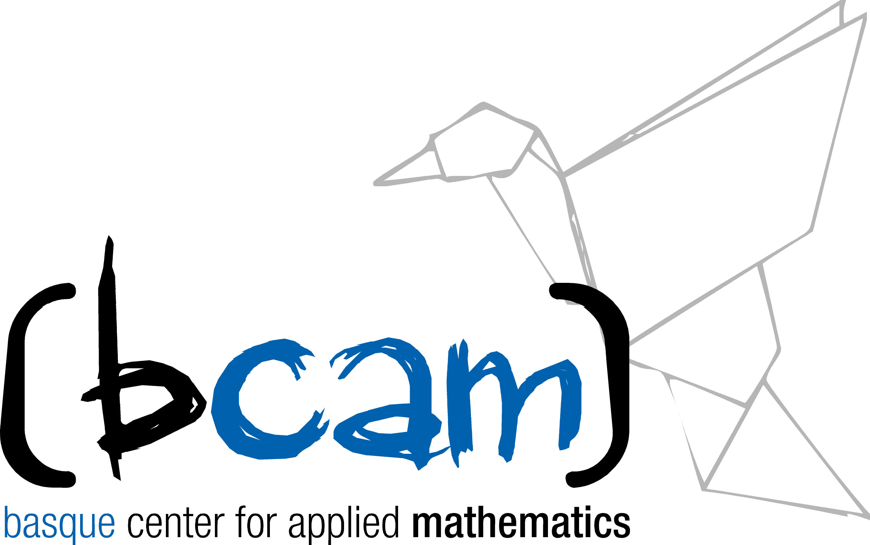

Knowledge Transfer between Mathematics Industry and the Society
Alicante, 2 November 2017

Slide 2
Outline
BCAM
Knowledge Transfer Unit
Collaboration Models
Success Stories with Industry

Slide 3
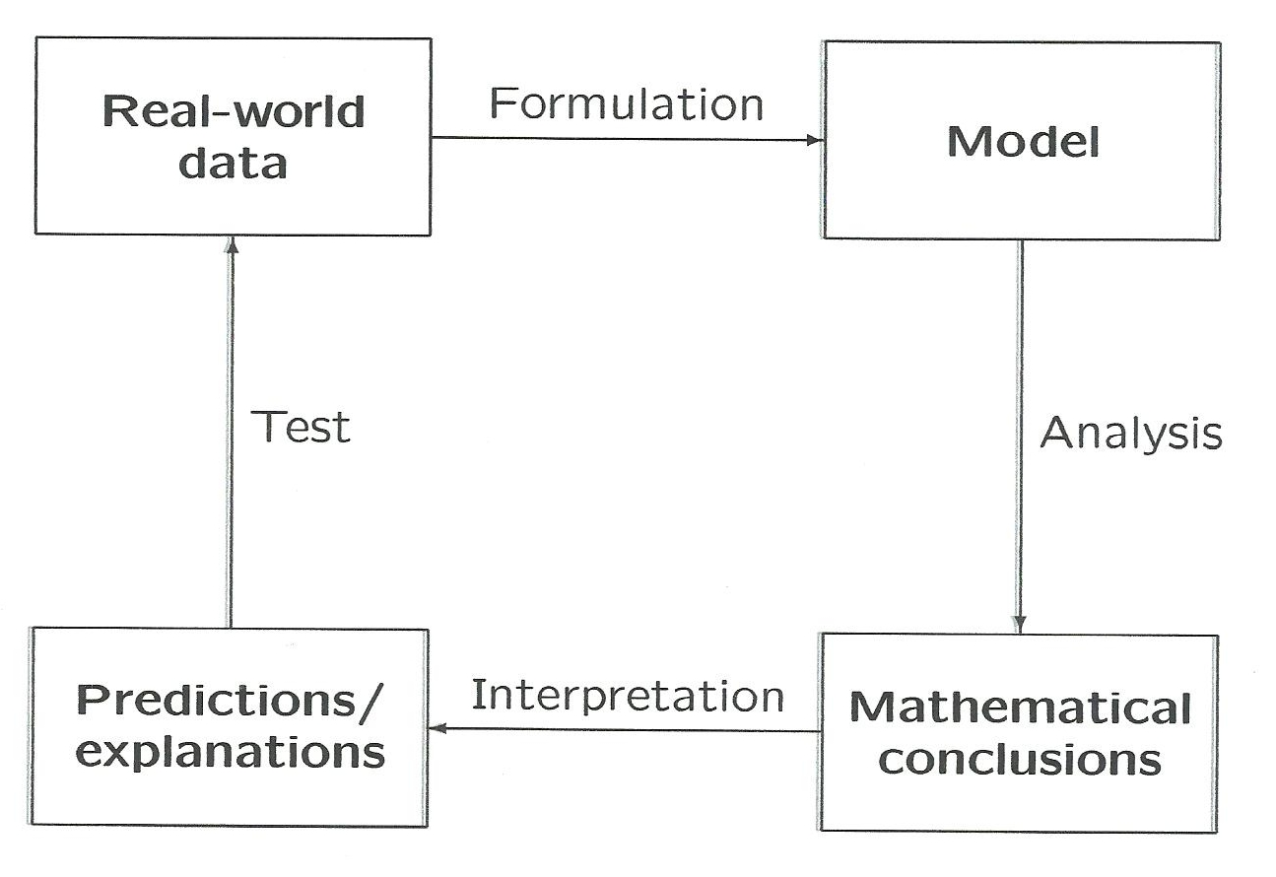
Mathematical Modelling Process

Slide 4
Co-creating Value with Research in Mathematics
How:
Developing new mathematical methods and software
Adapting existing ones
Experts from the practice and mathematicians have to work together in order to solve a real-world problem.
They must determine a common language to define and describe a problem.

Slide 5

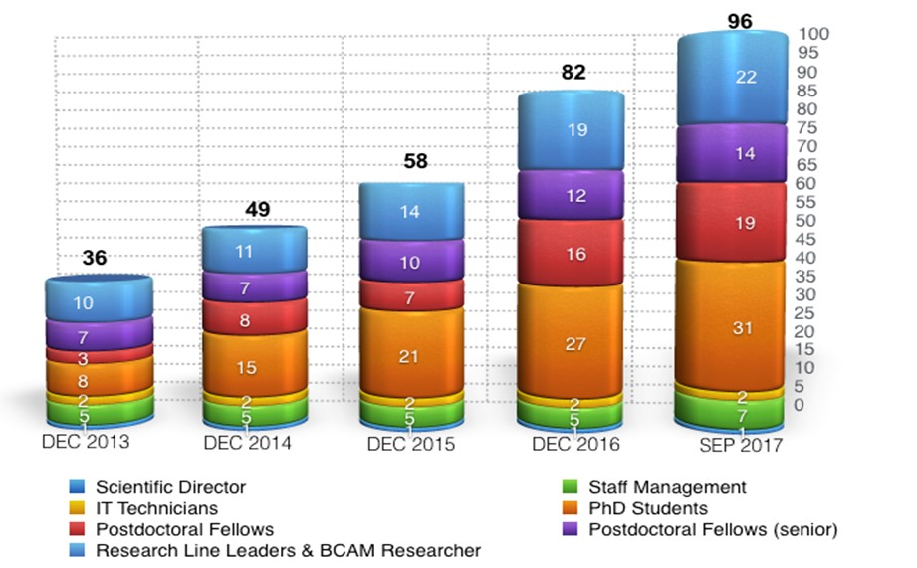
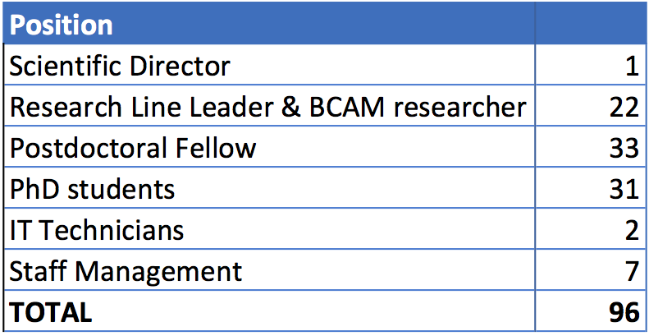
BCAM – Basque Center for Applied Mathematics
BCAM is a research centre constituted in 2008 as a non-profit association.
Aligned with the Basque Science & Technology Strategy within BERC (Basque Excellence Research Center) network and collaborating with the University, Technology Centres, Corporations and the rest of the R&D&I agents.
BCAM was awarded in 2014 by MINECO with accreditation.
NOTE: additionally there is an average of
10 visiting researchers (visiting fellows and interns)
at the center

Slide 6
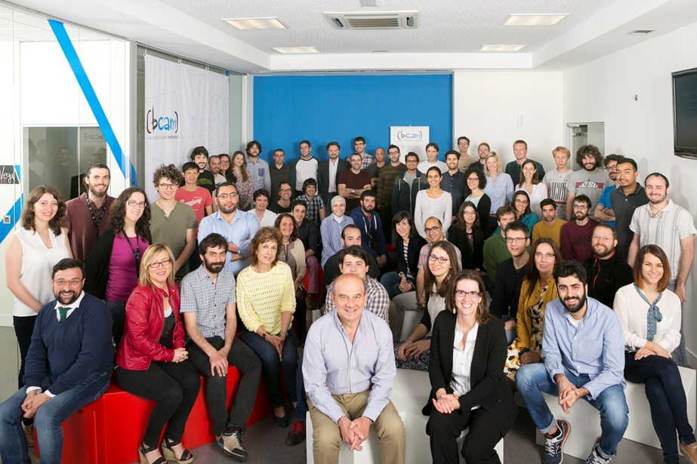
BCAM – Basque Center for Applied Mathematics
BCAM is a research centre constituted in 2008 as a non-profit association.
Aligned with the Basque Science & Technology Strategy within BERC (Basque Excellence Research Center) network and collaborating with the University, Technology Centres, Corporations and the rest of the R&D&I agents.
BCAM was awarded in 2014 by MINECO with accreditation.
NOTE: additionally there is an average of
10 visiting researchers (visiting fellows and interns)
at the center

Slide 7




BCAM Research Areas
Computational Mathematics
Mathematical Modelling
Mathematical Physics
Analysis of Partial Differential Equations
Data Science

Slide 8
BCAM mission: “Mathematics in the service of society”
Excellence research in the frontiers of mathematics
Interact with industry and R&D&I agents
Disseminate mathematics and its applications within society
Train and attract talented scientists
Become a relevant node in the international mathematics research network
Knowledge Transfer
(Mathematical Modelling Process)

Slide 9
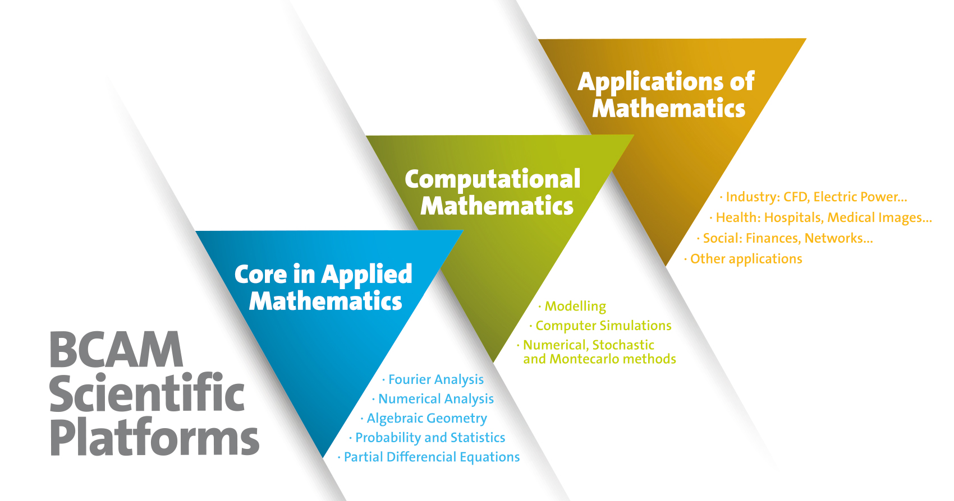
BCAM Scientific Platforms

Slide 10
BCAM - Knowledge Transfer Unit
The aim is to coordinate contacts to external actors and builds up a database of potential partners for applied projects.
In particular, highest opportunities to transfer knowledge to society are in the following research areas:
Computational Mathematics
Data Science
Mathematical Modelling with Multidisciplinary Applications
We are flexible in terms of collaboration models, customizing our offer to suit the specific needs of each company/partner.

Slide 11


Collaboration Models
Strategic Partnerships
BCAM’s capabilities are aligned with the cross-technology domains of the RIS3* Euskadi Strategy, which defines 3 smart specialization priorities:
Advanced Manufacturing
Energy
Biosciences and Health
Joint Research Labs
on Big Data (with Tecnalia and UPV/EHU)
on Offshore Renewable Energy
Member of Committee of the BCSC – Basque Cybersecurity Center
*RIS3: “Research and Innovation Strategies for Smart Specialization”

Slide 12

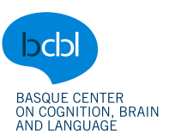


Collaboration Models (cont.)
Collaborative projects and agreements (e.g.: external funding, grants, or contracts)
BCAM researchers supervise Master and PhD Thesis in collaboration with companies (real-problems with mathematical solutions)
Joint positions
Innovative formula for knowledge transfer
Research positions supported by BCAM and the company / research center:
Training courses for industrialists

Slide 13
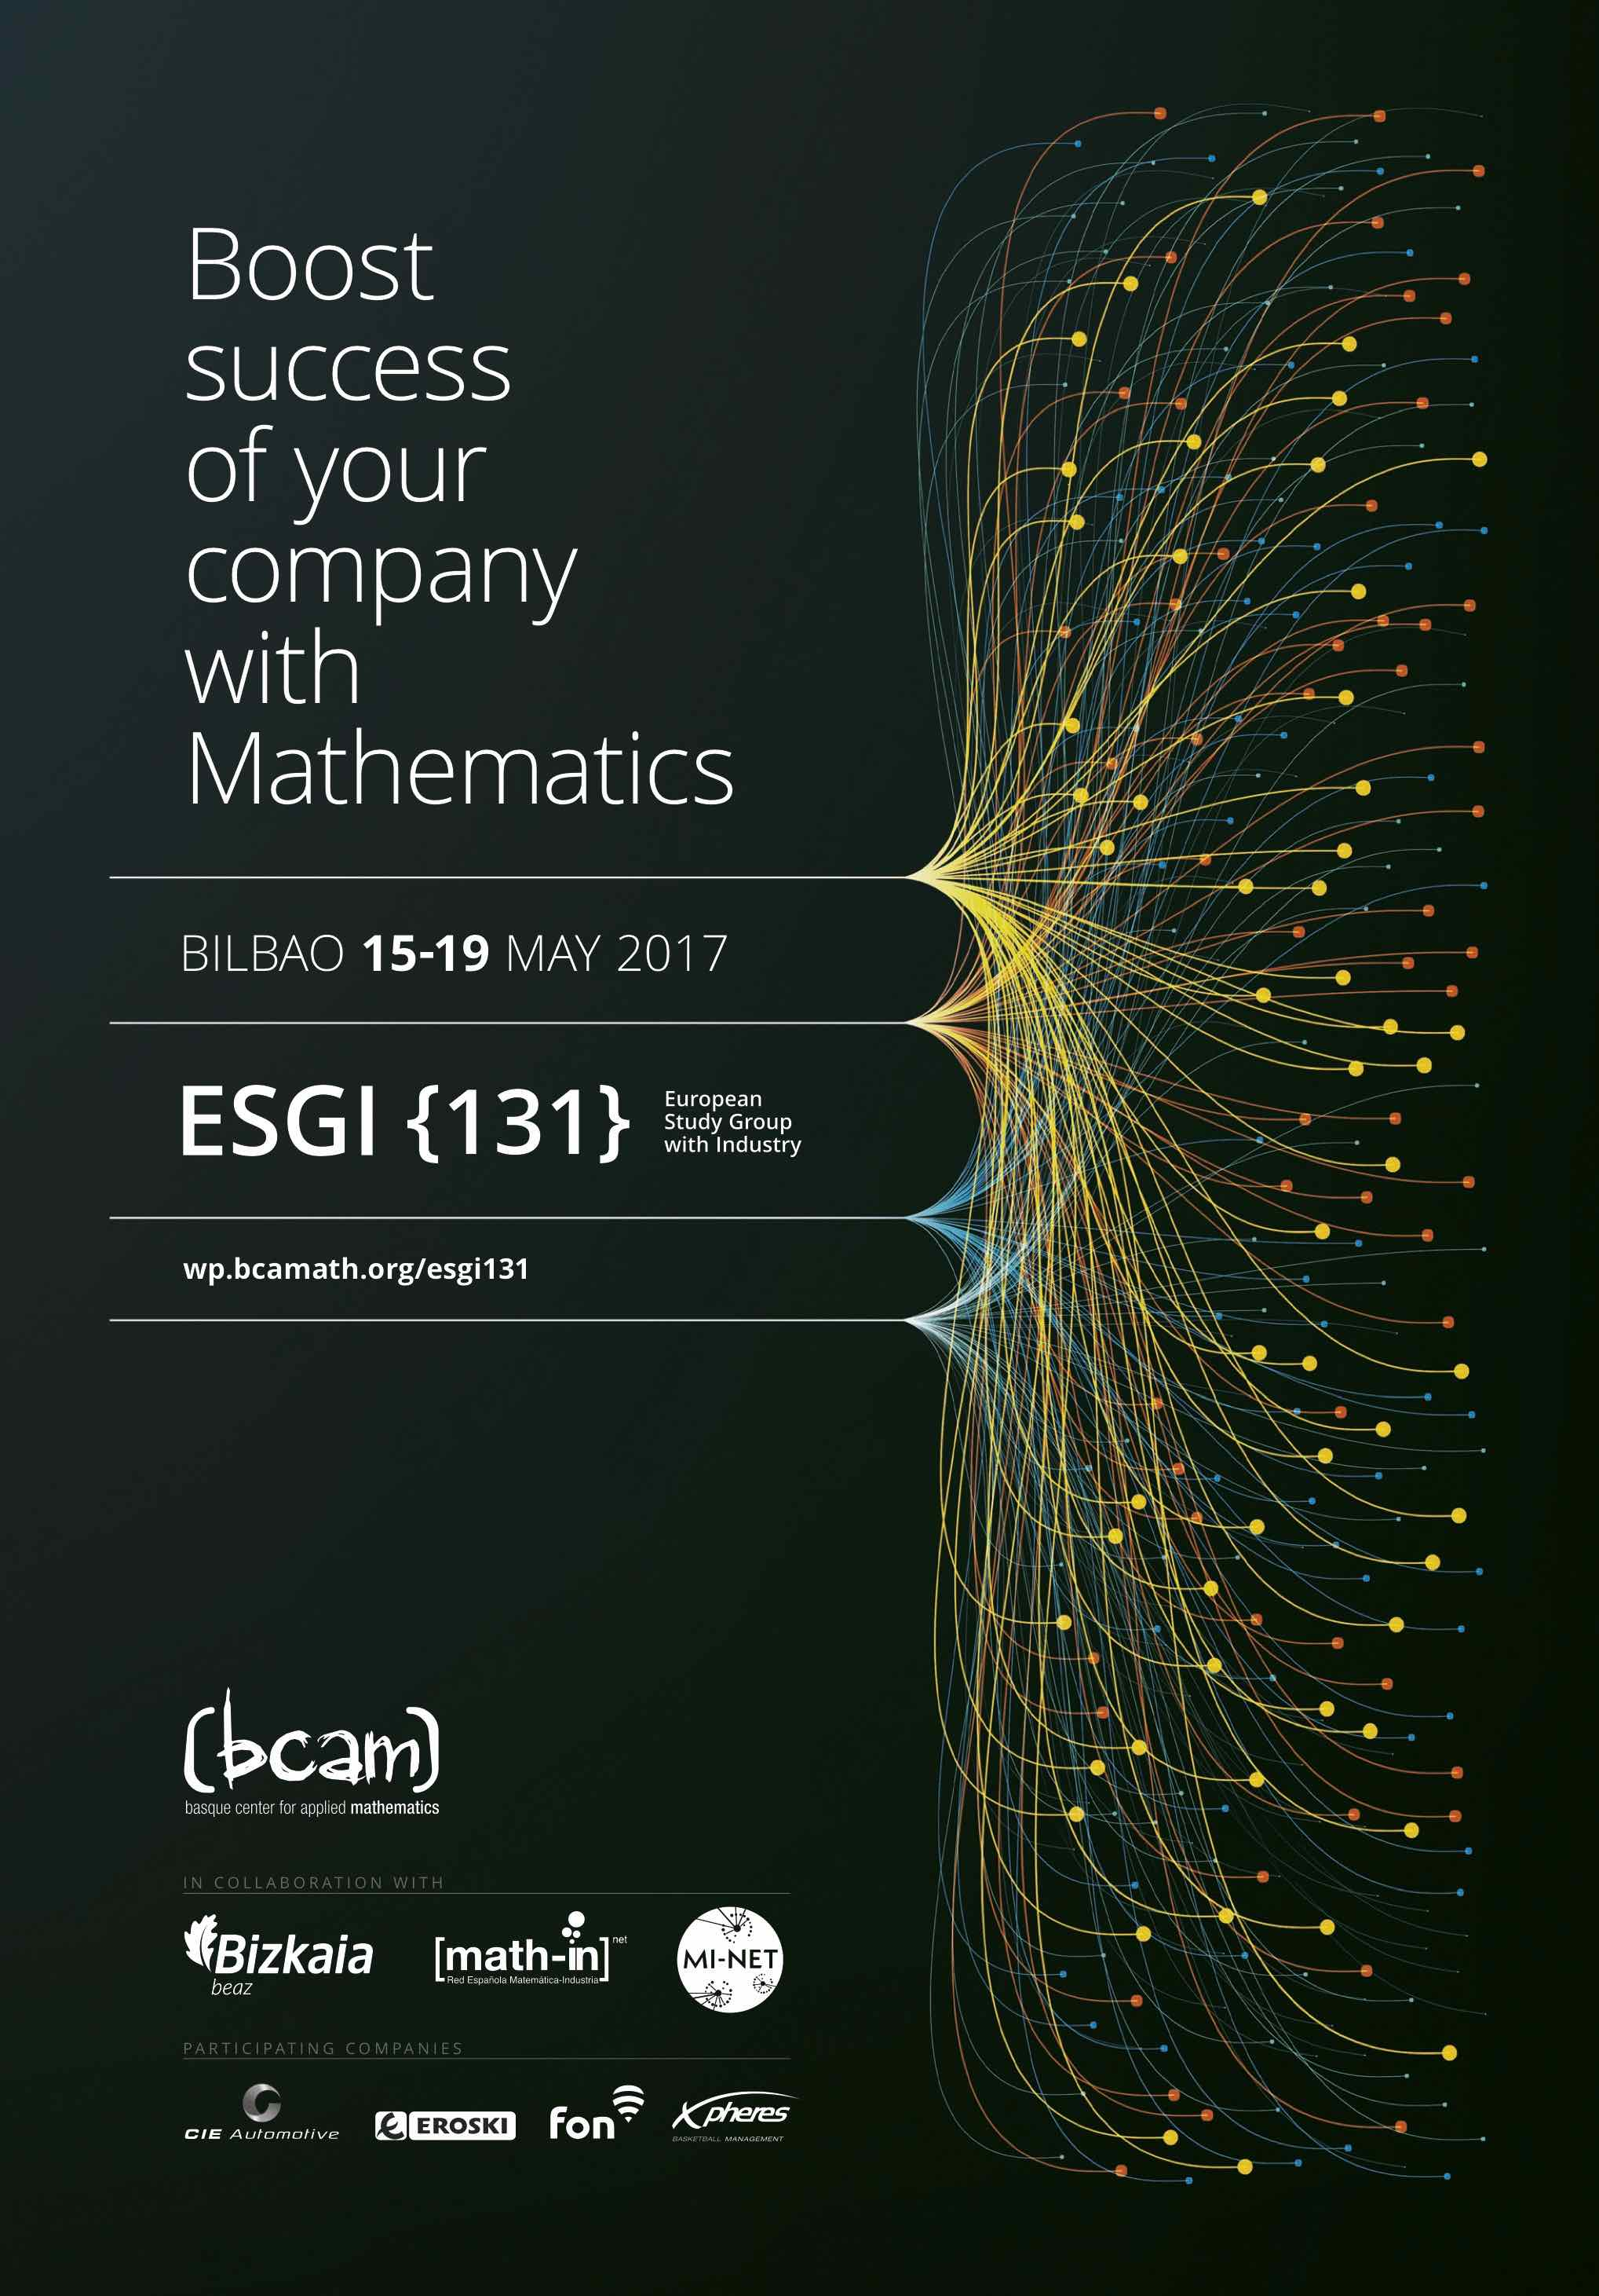
ESGI - European Study Group with Industry
Starting in Oxford in 1968.
131st edition held in Bilbao 15-19 May 2017
ESGIs are internationally recognized as problem-solving forums for knowledge transfer.
Industrialists bring a problem to one of these week-long brainstorming workshops that are attended by a group of mathematicians with varied expertise.

Slide 14
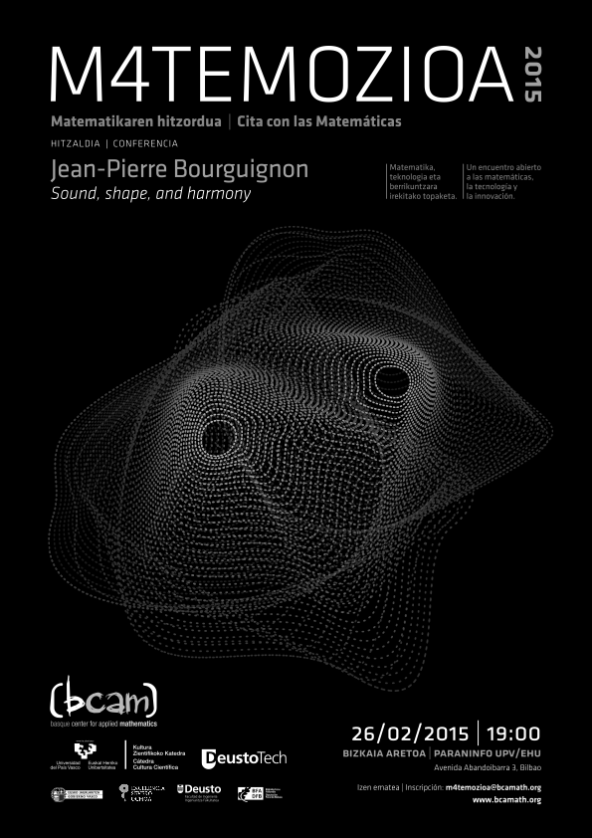
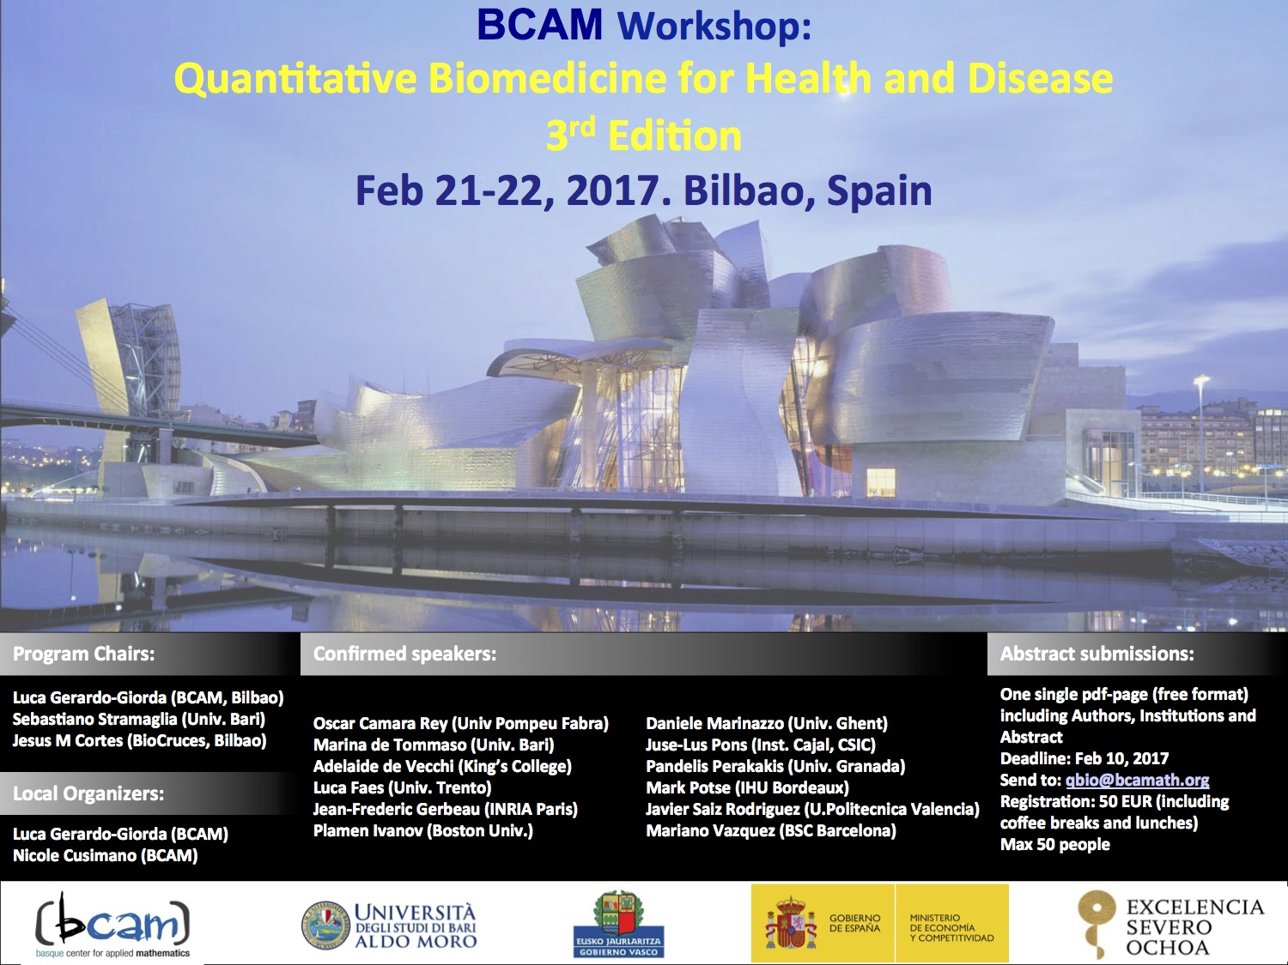
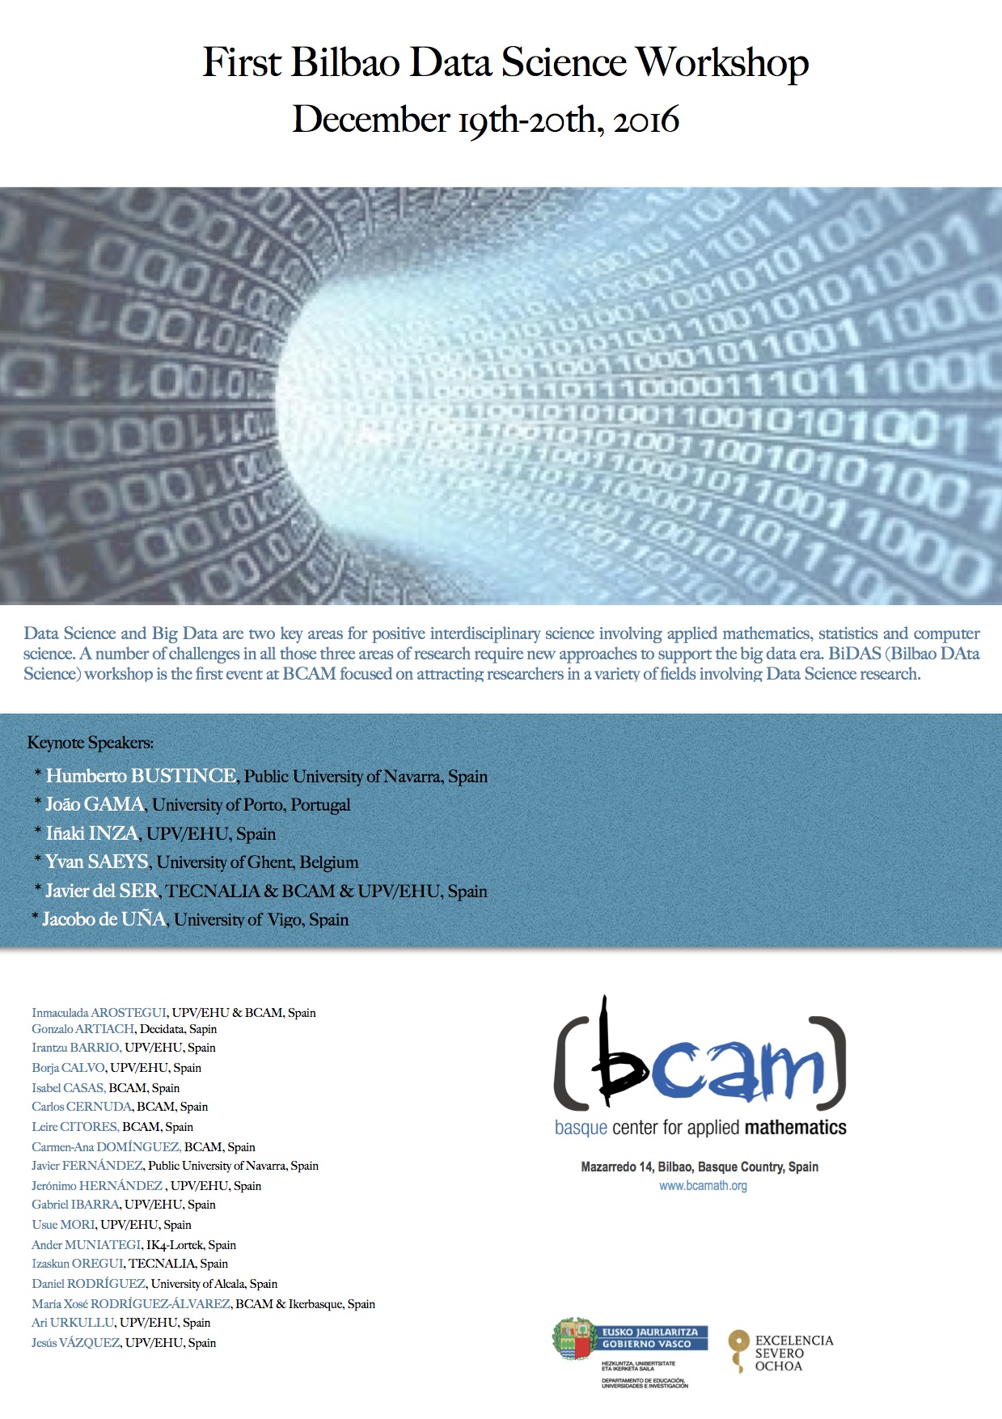
Dissemination Activities
Specialized workshops, seminars and courses for researchers
Joint workshops with industry and health sector
Numerical Resolution of Inverse Problems
QBIO – Workshop on Quantitative Biomedicine for Health and Disease
Bilbao meeting on Analysis and PDEs
Fractional Calculus, Probability and Non-Local Operators: Applications and Recent Developments
BiDAS – Bilbao Data Science Workshop
Workshop on Nonlinear Dynamics in Biological Systems

Slide 15



Dissemination Activities
3. Dissemination for the general public about Mathematics interacting with culture

Slide 16




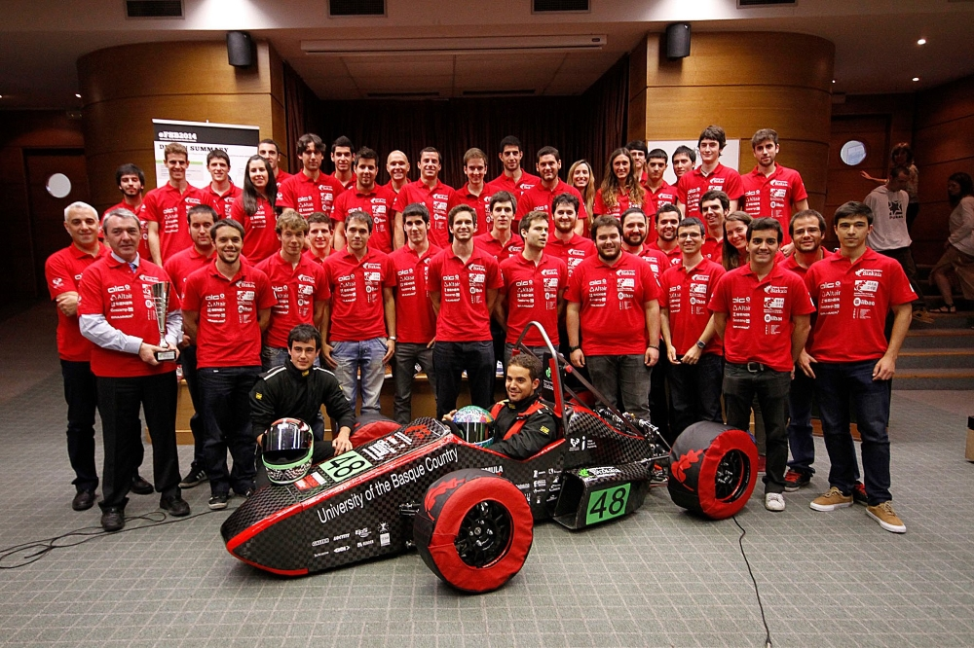
Dissemination Activities
4. Promote scientific vocation and gender balance
“Inspire young girls in Science and Technology”
Young students with high capacities visit BCAM in order to explore in depth the role of researchers in our daily lives.
training
and technical advice

Slide 17

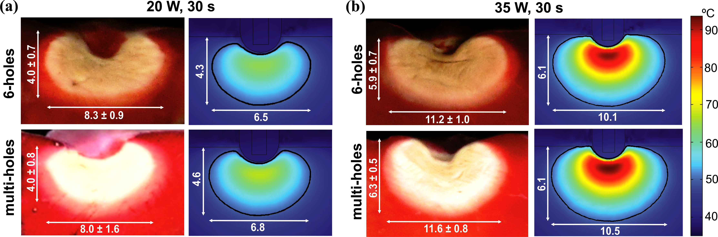
Success Stories with Industry
 | Project: Computational modelling for cardiac radiofrequency ablation Goal: Explore if the optical information recorded would predict the size and quality of the thermal lesion created in the cardiac tissue. Success indicator: Better understanding of biophysics and more accurate diagnosis of cardiac tissue.
Research article: “Computational Modeling of Open-Irrigated Electrodes for Radiofrequency Cardiac Ablation Including Blood Motion-Saline Flow Interaction” Plos ONE (2017)

Slide 18

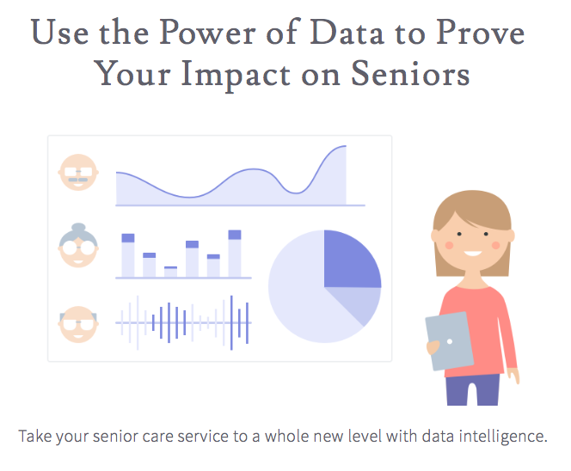
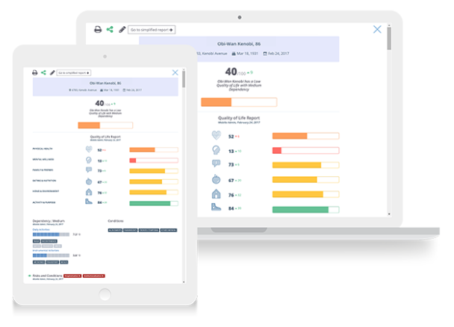
Success Stories with Industry
 | Project: Statistical analysis of SeniorGrowth assessment tool for Quality of Life of senior people Goal: One of the objectives was to build a predictive model that links specific care actions with corresponding risks and conditions. In addition, Quality of Life statistical models with benchmark comparisons were built. Success indicator: International private funding.

Slide 19

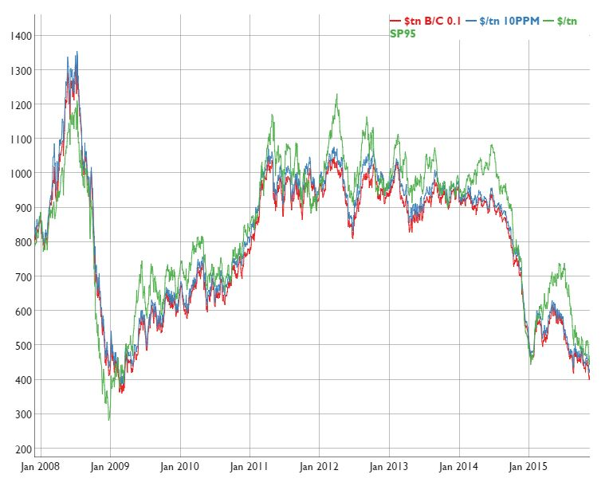

Success Stories with Industry
 | Project: Analysis of oil price market Goal: Adjustments in the pricing policy considering probabilistic approaches and scenario analysis. Efficient support for decision making and risk analysis. Success indicator: Better understanding of the market data for decision making.

Slide 20

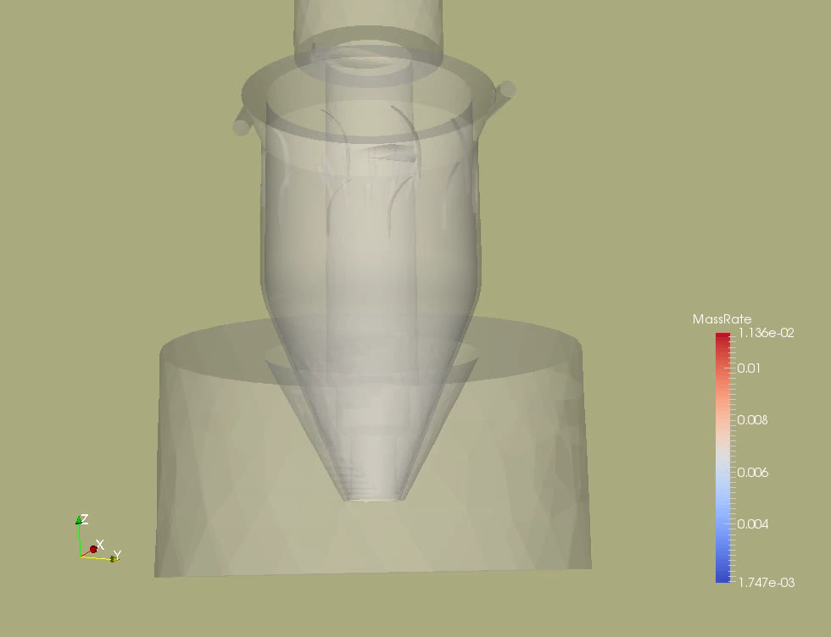
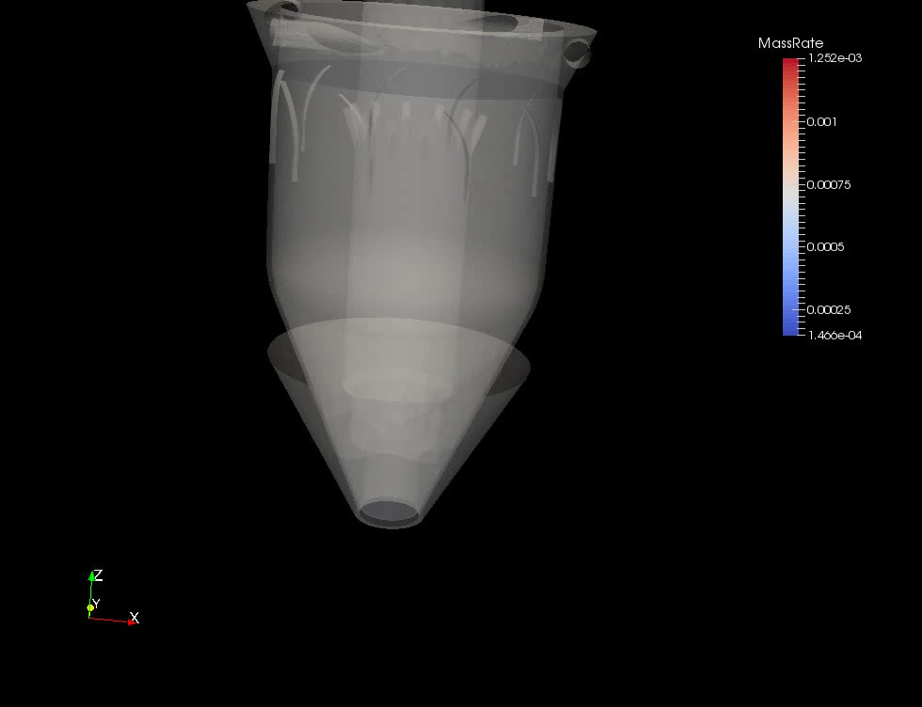
Success Stories with Industry
 | Project: Reduction of beam deposition processing time within the framework of “FRACTAL – Development of Spanish-Technology-Based Advanced Manufacturing and Prototyping Systems for Strategic Components via Laser Assisted Powder Sintering”. Goal: Design a suitable powder feeding system to be used with the laser device developed by ETXE-TAR. Success indicator: The project was funded by CDTI through CIEN Strategic Programme.

Slide 21

















BCAM & Industry/Society

Slide 22
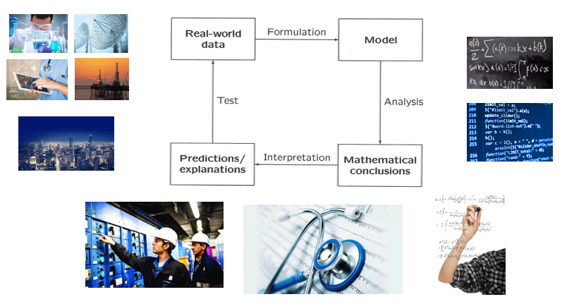
Co-creating Value with Research in Mathematics

Slide 23
Thank you!
Eskerrik asko!
¡Muchas gracias!

